Slide 1
Digital Marketing – Paid Campaign Results
- Shenbaga Devi C

Slide 2
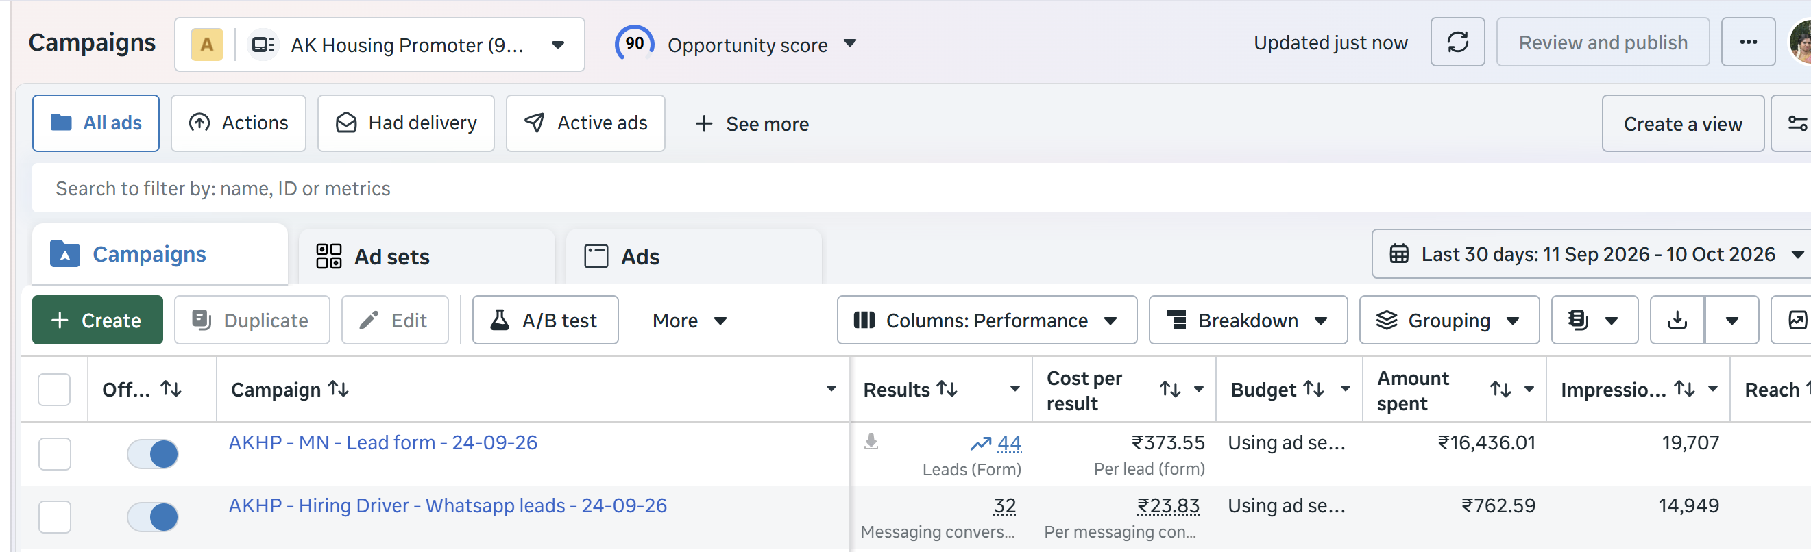
Real Estate Client :

Slide 3
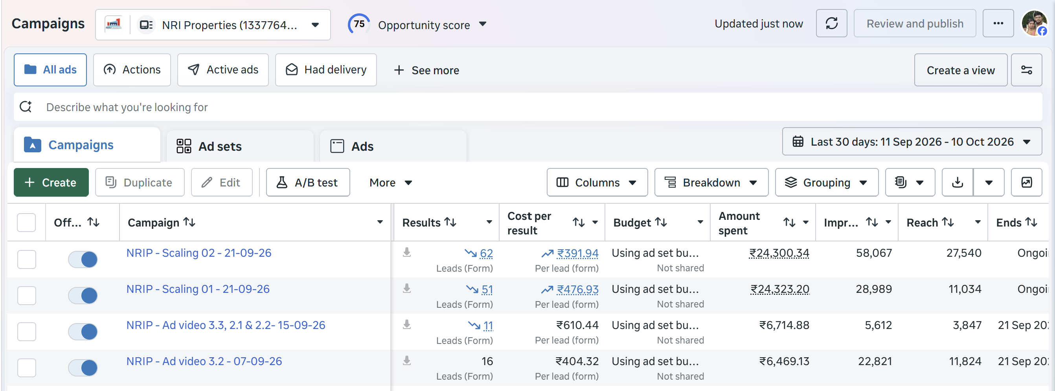
Real Estate Client :

Slide 4
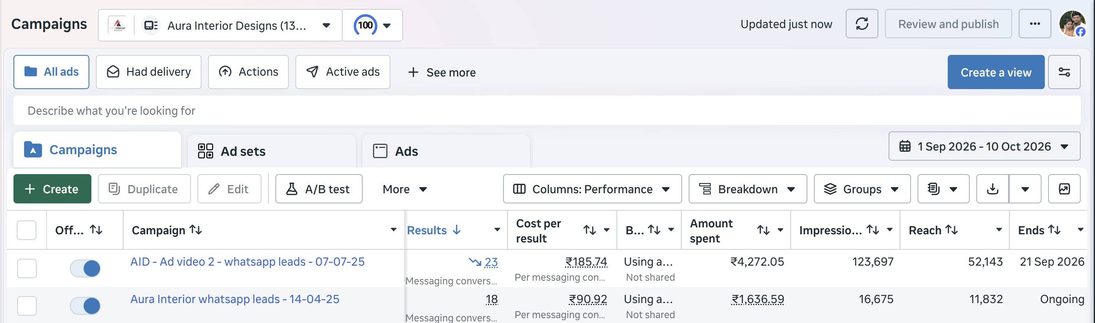
Interiors and Architecture Client :

Slide 5
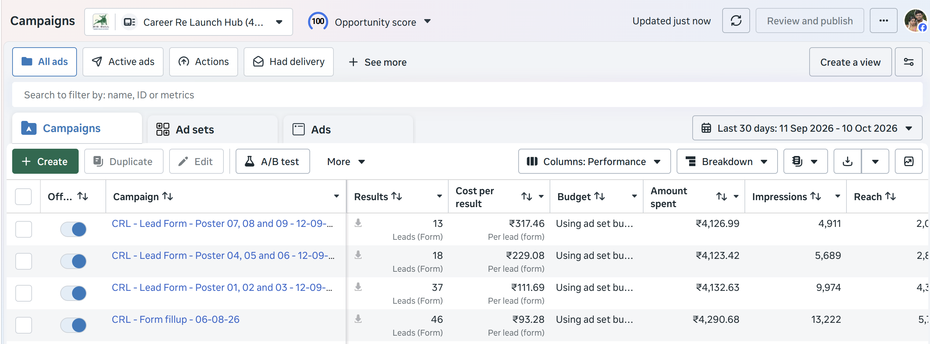
Career Re - Launch Program :

Slide 6
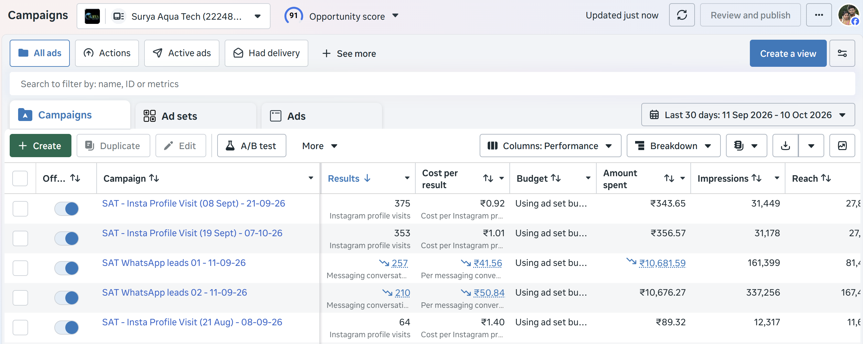
Aqua Tech Business :

Slide 7
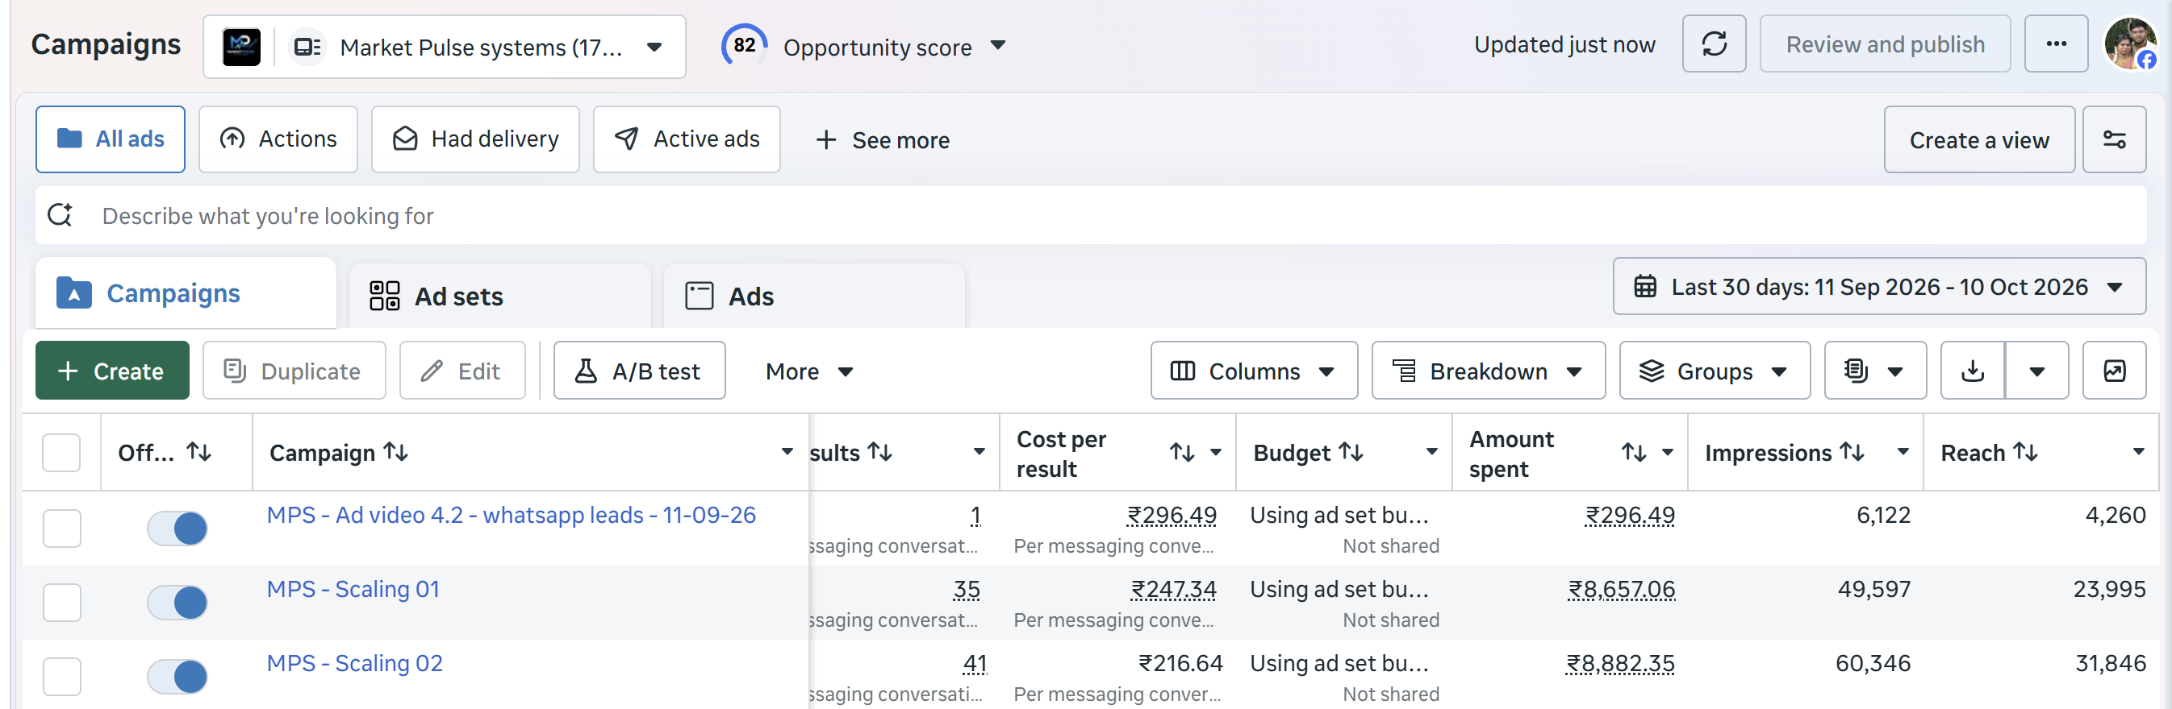
AI – Software Selling Business :

Slide 8
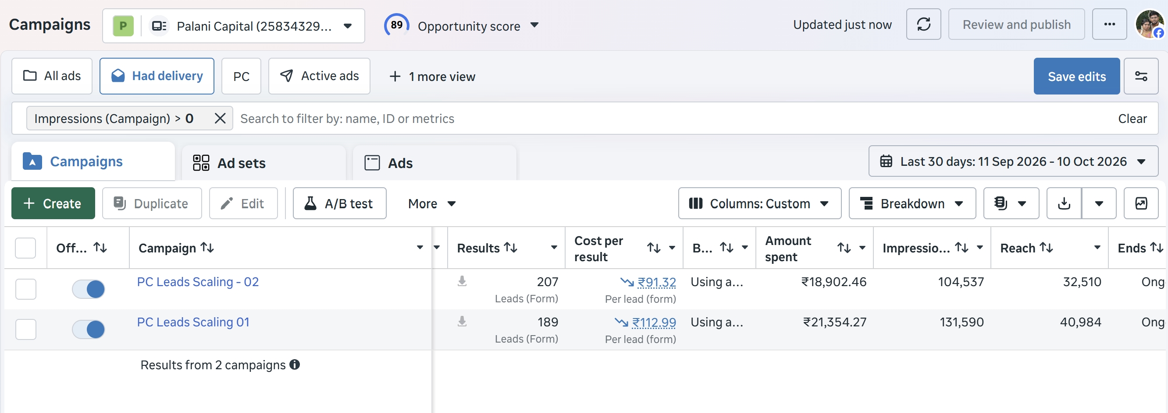
Mortgage Loan Business :

Slide 9
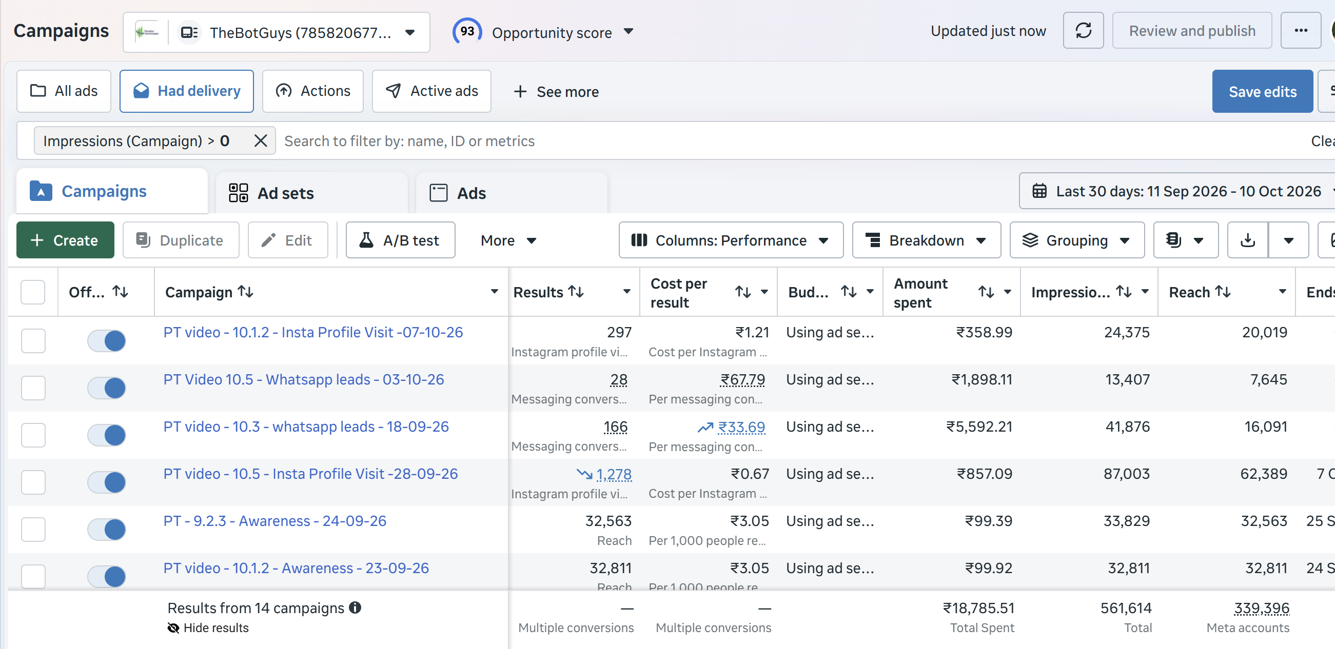
Trading Software :

Slide 10
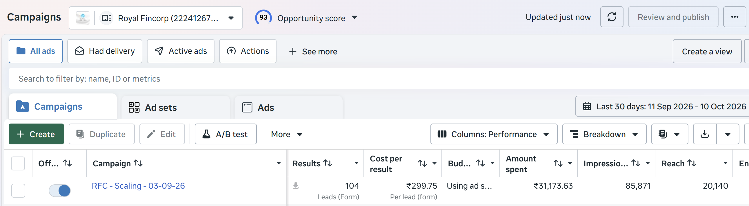
Business Loan Client :

Slide 11
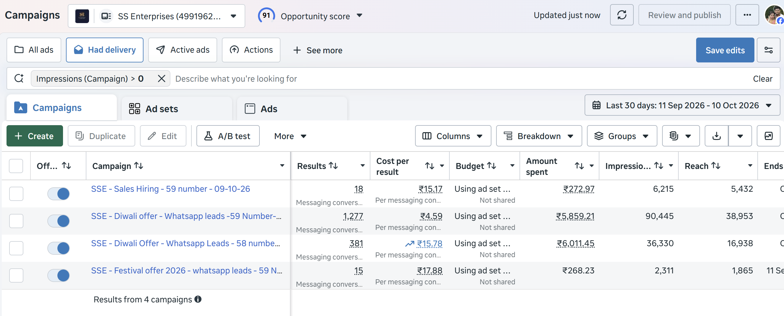
Electronic Shop:

Slide 12
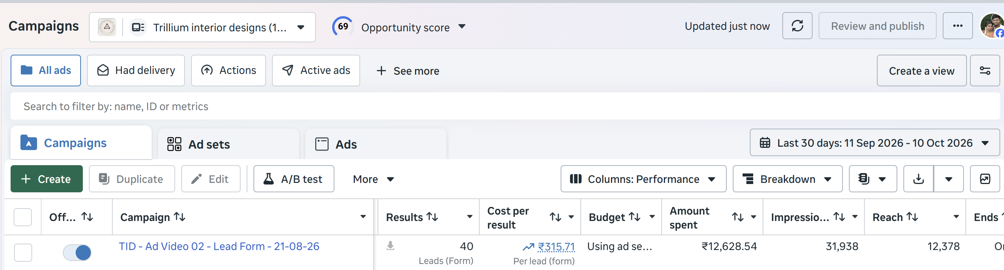
Interior Designer Client :

Slide 13
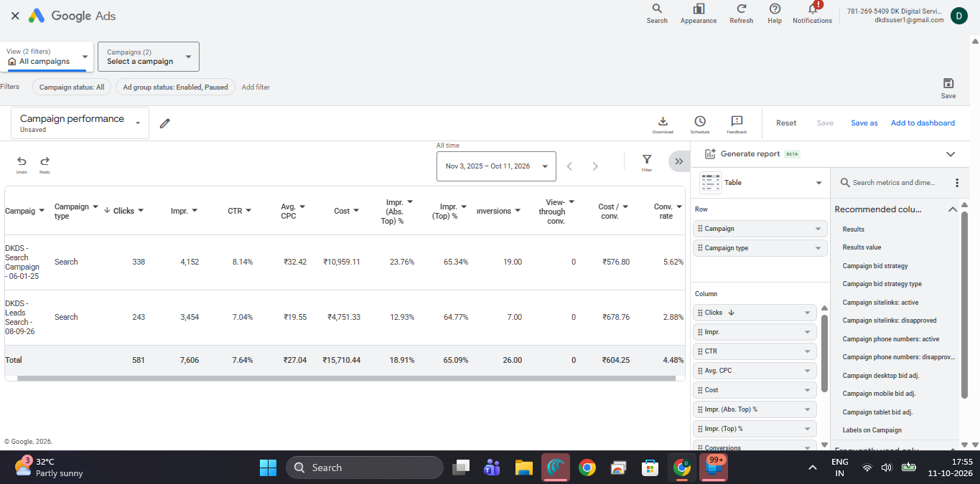
Marketing service client – Google ads

Slide 14
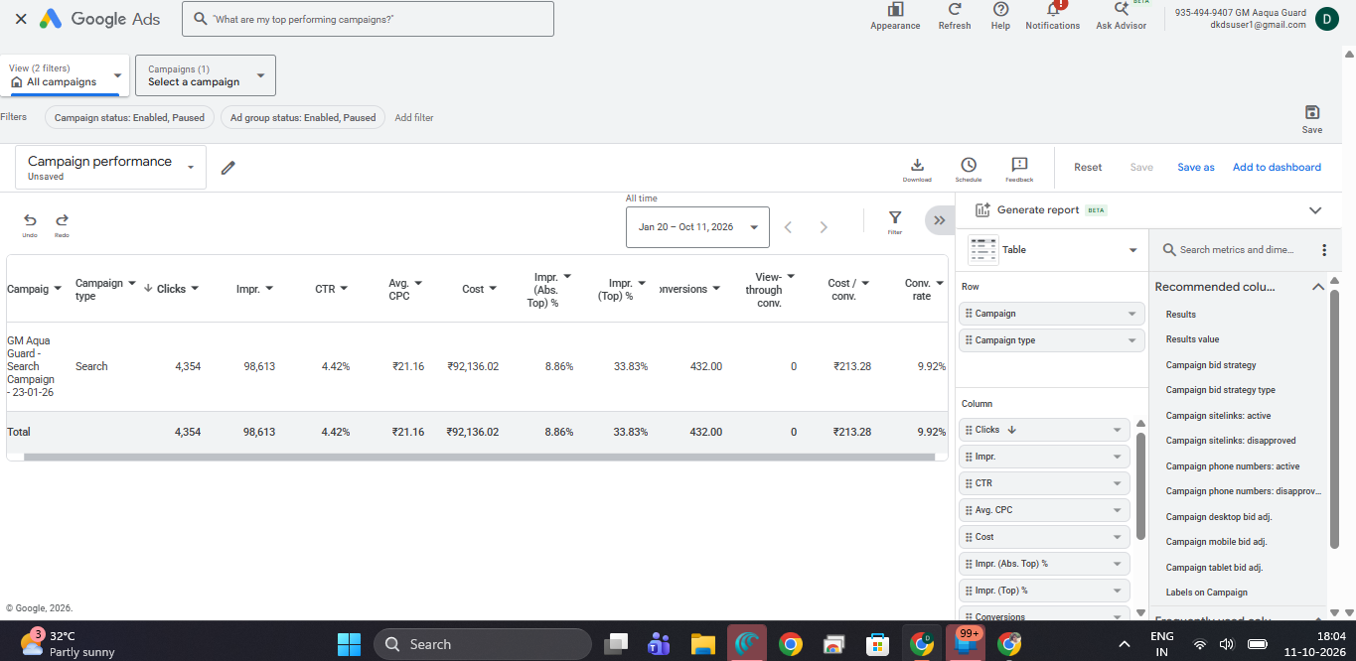
Aqua Tech Business

